Slide 1
J.CHARLE MARO
Final Project

Slide 2
BRAIN TUMOUR DETECTION USING CNN

Slide 3

AGENDA
Problem Statement
Project Overview
Who are the end users?
Your solution and its value proposition
The Wow in your solution
Modelling
Results

Slide 4

PROBLEM STATEMENT
Brain tumour diagnosis from MRI scans is labor-intensive and subjective. This project focuses on creating a Convolutional Neural Network (CNN) solution to automate this process. Key tasks include data preparation, CNN architecture design, model training, metric definition, and clinical integration. The aim is to enhance diagnostic accuracy and streamline brain tumour detection for better patient outcomes.

Slide 5

PROJECT OVERVIEW
A more imaginative and adaptable approach to creating models with greater complexity is provided by the Keras Functional API. A model that performs multiple supervised prediction types (such as regression and classification predictions) introduces a certain level of complexity. Used libraries :
Pandas – An open-source library to read and manipulate datasets. Here it was used to read the CSV file which contained pixel values for the image
Numpy – An open-source library with functions for high-level mathematical calculations as well as handling data that spans multiple dimensions
Matlplotlib – An open source library which is used to visualize our data and losses in our prediction model
Sklearn – This library consists of pre-defined functions and evaluation metrics that help in data preprocessing, model performance evaluation and model initialization.
Tensorflow – Developed by Google, It provides many methods to interpret data but mainly focuses on training and inference of Neural Networks

Slide 6


WHO ARE THE END USERS?
A more imaginative and adaptable approach to creating models with greater complexity is provided by the Keras Functional API. A model that performs multiple supervised prediction types (such as regression and classification predictions) introduces a certain level of complexity. To develop a model with regression and classification capabilities, we will dissect a comparable situation.
There are several potential end users for a project on "Gender and age prediction using CNN":
1. Medical Professionals
2. Healthcare Institutions
3. Patients
4. Medical Technology Companies
5. Research Community:

Slide 7

YOUR SOLUTION AND ITS VALUE PROPOSITION
Focus on Improved Accuracy and Transparency:
Large, Diverse Dataset: Make use of a sizable face dataset that spans a variety of ages, genders, ethnicities, and facial features. This lessens bias in the model's predictions and encourages generalizability.
Multi-stage CNN Architecture: Create a CNN architecture with several stages, each focused on extracting a different amount of information from the picture. This makes it possible for the model to accurately predict age by capturing both fine- and coarse-grained features, such as wrinkles and facial shape.
Real-time Processing: Make the model as resource-efficient as possible for real-time processing on devices. This makes it possible to verify age and gender in applications such as secure access control.

Slide 8

Proposition:
With accuracy, transparency, and responsible AI practices as top priorities, this project suggests a CNN-based age and gender prediction system. Explainable AI will be utilised in conjunction with a varied dataset to train the model, guaranteeing impartial and equitable predictions.
By emphasising privacy-preserving methods and real-time processing, the system can be integrated into different applications without compromising user privacy.

Slide 9


THE WOW IN YOUR SOLUTION
Precision: Accurately identifies tumour locations, reducing false results.
Efficiency: Automates MRI scan interpretation, freeing up healthcare professionals.
Timeliness: Enables rapid analysis for prompt treatment planning.
Scalability: Easily integrates into existing workflows for seamless adoption.
9

Slide 10
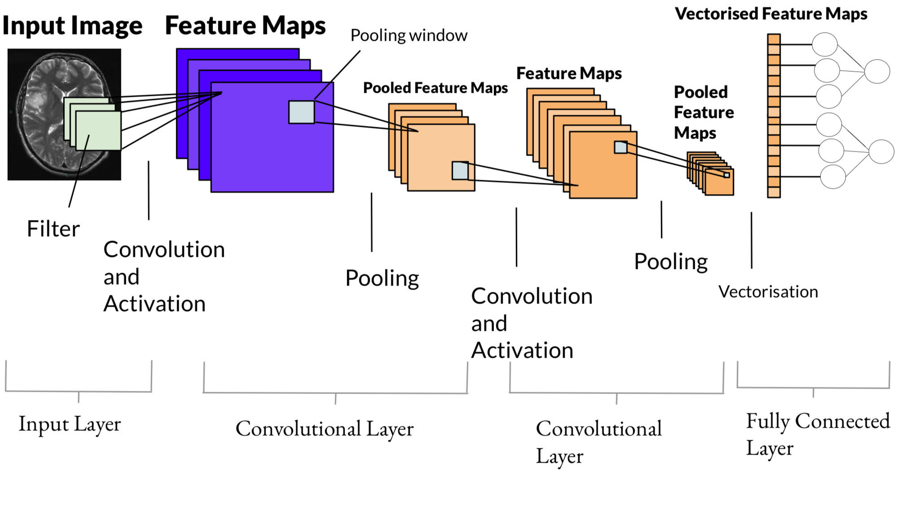
MODELLING
10

Slide 11
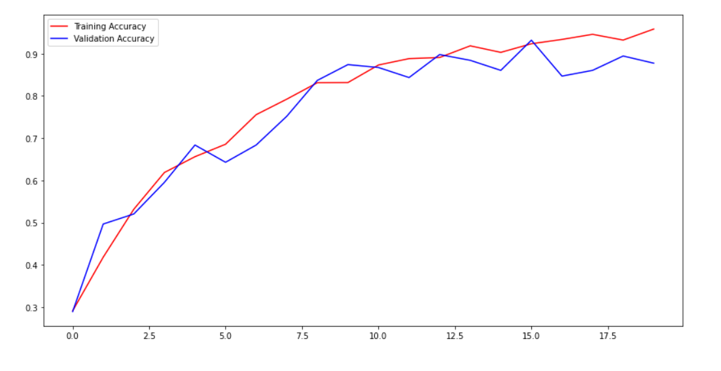
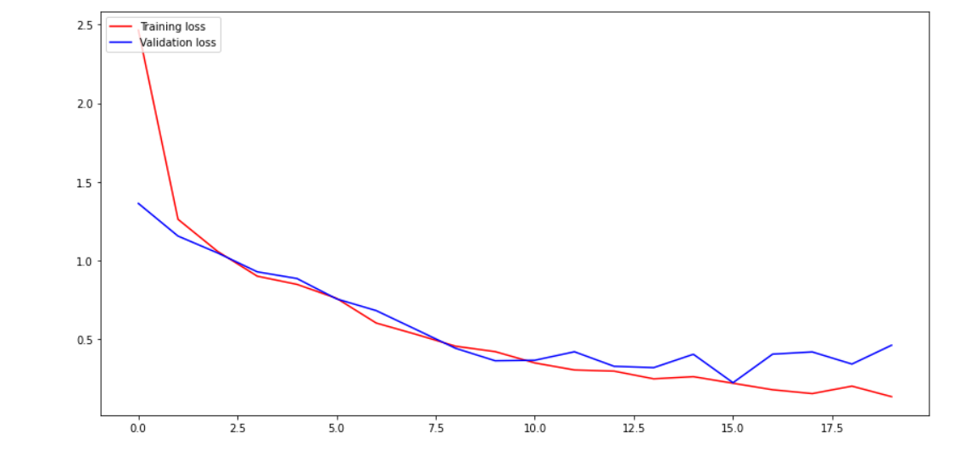
RESULTS
11

Slide 12
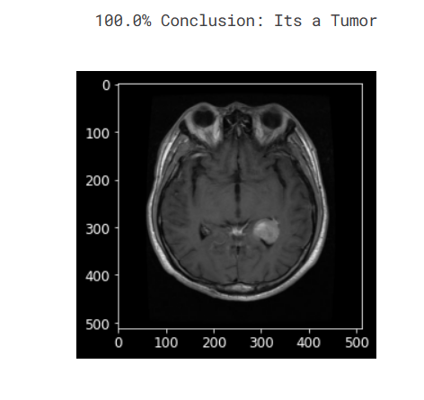

Slide 13
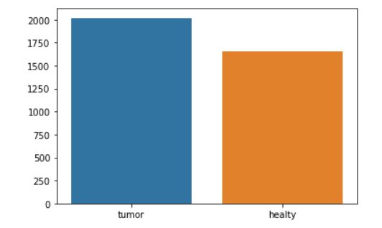
BRAIN TUMOUR DISTRIBUTION:

Slide 14
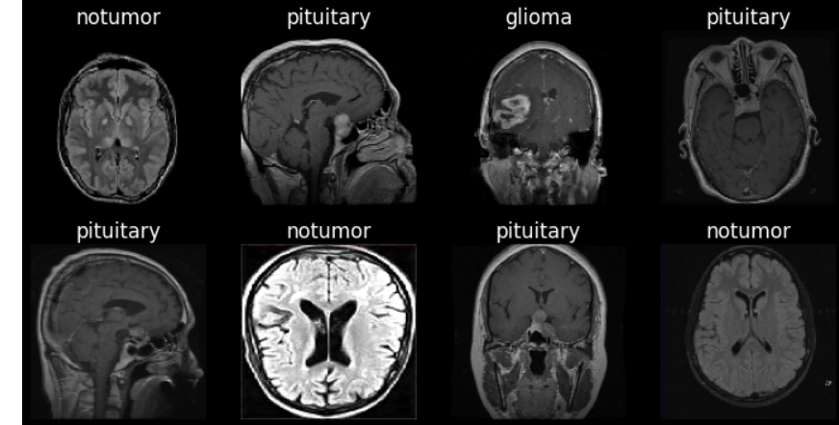

Slide 15
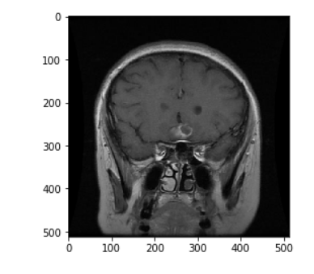
glioma_tumor =>1
meningioma_tumor =>2
no_tumor =>3
pituitary_tumor =>4

Slide 16
By following these steps, you can generate results that contribute to accurate and efficient brain tumour detection using CNNs, ultimately improving patient outcomes in clinical practice.
CNN Network
TUMOUR Accuracy: 90.00 Type: 3

